Slide 1
**NOT FOR PUBLIC USE**
This presentation is for LAW ENFORCEMENT AGENCIES to use as part of the Community Notification process. This presentation should only be modified by law enforcement to meet the needs of their department and communities for the purpose of SVP Community Notification.

Slide 2


COMMUNITY NOTIFICATION
Your
insignia
here
_______Police Department
Notes:
Uniformed Police to Present this slide and welcome the audience
Substitute your own insignia
(This presentation has been developed by the Colorado Community Technical Assistance Team of the Sex Offender Management Board pursuant to C.R.S. 16-13-904 (2). The CNTAT was developed at the request of the Chief’s/Sheriff’s Association to help with community notification since this is an unfunded mandate. Please refer to the Criteria, Protocol & Procedures for Community Notification for SVPs in conducting this presentation. If it is your FIRST you MUST contact the SOMB at 303-239-4499 for assistance.)
Law enforcement has the option of revising the presentation at it’s discretion, but please be aware of the requirements of C.R.S. 16-13-904 (2) and legal liability. Furthermore, this presentation has been developed and revised over the years in conjunction with law enforcement officials based on years of experience with community notification and evidence based practices. The more slides that are taken out of this presentation tend to cause more questions from community members. There are trainer’s notes at the bottom of each slide to assist you in this presentation. It may be helpful to read from the notes or use them as talking points because reading the slides doesn’t present well. Please contact the Sex Offender Management Board for questions at 303-239-4499.
This presentation should be pre-empted by a pre-planning meeting so that all panel members are aware of their role in the meeting and are on the same page. You are encouraged to print this out with the trainer’s notes option and review it with all panel members prior to the meeting. For questions about this presentation or the Criteria and Protocol for Community Notification, please contact the Office of Sex Offender Management at the Division of Criminal Justice at 303-239-4499.

Slide 3

SEX OFENDER LEGISLATIVE HISTORY
National Sex Offender Legislation
  Jacob Wetterling Act 1994
  Megan’s Law 1996
  Pam Lychner Act 1996
  Campus Sex Crimes Prevention Act 2000
  Adam Walsh Act 2006
Notes:
LE or District Attorney or CNTAT/SOMB present this slide
“In the mid 1990’s, the following federal sex offender laws were passed.”
Wetterling Act-requires states to establish sex offender registration for convicted offenders, and a system to track them. In 1989 Jacob Wetterling, 11, and his brother, Trevor, 10, and a friend were riding their bikes, returning home from a store in St. Joseph, MN. A masked man came out of a driveway and ordered the boys to throw their bikes into a ditch, turn off their flashlights, and lie face down on the ground. The gunman asked each of the boys his age. He told Trevor and his friend to run to the woods and not look back or he would shoot them. As they ran they saw the gunman grab Jacob’s arm. They reached the woods and noticed Jacob and the gunman were gone. Jacob’s never been found. Investigators learned that halfway houses in St. Joseph housed sex offenders after their release from prison. Jacob’s mother advocated for missing children and was appointed to a Governor’s Task Force that recommended stronger sex offender registration requirements in MN.
Megan’s Law-requires states to inform community residents about the presence of convicted sex offenders in their neighborhoods. In July, l994, 7 year old Meagan Kanka accepted an invitation from a neighbor to see his new Puppy in New Jersey. The neighbor was a 2-time convicted pedophile. He raped & murdered her and dumped her body in a nearby park. Her parents said that they never would have allowed her to travel the neighborhood freely if they had known that a convicted sex offender was living across the street.
Lychner CN Act-amended the Wetterling Act by mandating lifetime registration for some sex offenders, and mandating a national sex offender registry (maintained by FBI) Houston Real Estate Agent Pam Lychner prepared to show a vacant home to a prospective buyer. Awaiting her at the house was a 2-time convicted felon who brutally assaulted her. Her husband arrived and saved her life. She then formed “Justice for All”, a victim’s rights advocacy group that lobbies for tougher sentences for violent criminals. Lychner and her two daughters were killed in the explosion of TWA flight 800 off the coast of Long Island in July l996. Later that year, Congress passed the Pam Lychner Sexual Offender Tracking and Identification Act of l996 in her memory.
Campus Sex Crimes Prevention Act – amends the Wetterling Act, requiring offenders to report information regarding any enrollment or employment at an institution of higher education and to provide this information to a law enforcement agency whose jurisdiction includes the institution. Based upon Jeanne Clery: 19 year old freshman from Lehigh University Raped & murdered April 5, 1986, while asleep in her residence hall; Parents discovered there were 38 violent crimes on campus that students were unaware of. School must disclose crime statistics; School must provide notice of where registered sex offender information may be located, such as IP address; Local LE agency; Campus LE agency;
Adam Walsh Act requires a national registry with an offense based tiered system and particular notification requirements for consistency among states and tribes. Colorado is compliant with the act.
The purpose of these laws is to provide law enforcement and communities greater access to information about the sex offenders in their communities.
These laws have been the basis for sex offender policy in Colorado for registration and community notification.

Slide 4

COLORADO SEX OFFENDER LEGISLATION
Colorado Sex Offender Legislation
  SVP Definition 18-3-414.5 C.R.S.
  Community Notification 16-13-901 C.R.S.
  Sex Offender Registration 16-22-101 C.R.S.
Notes:
LE or Probation or CNTAT/SOMB or DA present this slide
Sex Offender Registration
Those who were convicted on or after 1/1/91 of an unlawful sexual offense in Colorado or any other state.
Released from the Dept of Corrections after 1/1/91 after serving a sentence for an unlawful sexual offense.
Colorado includes a broader range required to register than are required federally. Colorado registration requirements include guilty pleas, nolo contendre, deferred judgments, adjudications and factual basis findings.
Registration may be required of juveniles and adults.
Adults can petition to be removed after 20 years, 10 years or 5 years (for misdemeanors).
Sexually Violent Predators and adults with multiple convictions register for life and CANNOT petition the courts regarding the cessation of registration.
Some juveniles can petition for an exception in limited cases.
Many juveniles can petition to be removed.
Lifetime Supervision-Is an indeterminate sentence up to the offender’s lifetime.

Slide 5
COMMUNITY NOTIFICATION IN COLORADO
Occurs in 2 ways in Colorado:
  Passive: Via the sex offender registration process whereby citizens seek information about offenders from law enforcement via website or in person at headquarters
  Active: Via notification from law enforcement to citizens through a meeting or alternative forms for higher risk sex offenders determined by the courts/parole board to be Sexually Violent Predators (SVPs)
Notes:
LE presents this slide:
Passive notification occurs when the citizen comes to Law Enforcement and requests a copy of the sex offender registry or looks on the website or internet for the information. Please note that the information contained on the paper list differs from what is found on the internet due to the statute. For complete information a paper list should be obtained.
Active notification occurs when Law Enforcement comes to the citizens, (as in this meeting), and provides information to the community.

Slide 6
WHAT DOES SVP MEAN
Via old assessment (administered prior to 7/2010)
According to research, previous assessment indicated SVP’s are 3x more likely to be arrested for a violent crime within 5 years of release from Department of Corrections
Via new assessment (administered during or after 1/2018) : More likely to commit a new sex or violent crime post-release
Notes:
DA, SOMB approved treatment provider, Probation/Parole or CNTAT/SOMB present the next several slides
All 50 states have some form of designation of the highest risk sex offender, like “SVP” or it’s equivalent. Some refer to them in levels or “tiers” with a numbering system. Our state refers to them as SVP’s. This is just a label, not a descriptor of a sexual offense. The research indicates the offender has the highest risk to commit a violent crime after release from incarceration.
In order for a person to ever be assessed as an SVP, they must first meet the “date, crime and relationship” criteria. They are as follows:
1. The offender must be 18 years or older at the time they committed the crime, or if they are a juvenile, be tried as an adult,

Slide 7
HOW SVP IS DETERMINED
Two (2) ways SVP is determined
1. Assessment conducted and court/parole board makes a finding
2. Offender moves to Colorado from another jurisdiction where he/she was ranked as the highest risk/registration level in that jurisdiction and CBI makes the finding (equivalency)
Notes:
There are two ways in Colorado an individual can receive the label of SVP: The first way is through the Colorado SVP Assessment tool.
The second way is if the offender is identified as an SVP, or its equivalent, in another state, and then moves here. Our state will honor that designation, which is determined through CBI.

Slide 8
CRITERIA FOR ASSESSMENT: Overview
Statutorily, the offender MUST meet specific criteria PRIOR to
undergoing the SVP assessment (SORS assessment):
Age
Date of offense & conviction
Crime of conviction
Relationship to victim
Notes:
The Colorado Revised Statute requires that an offender must meet specific criteria before undergoing the assessment.

Slide 9
CRITERIA FOR ASSESSMENT :Age
AGE
  The offender must be age 18 years or older at the time the offense was committed or tried as an adult if under the age of 18 when the offense was committed
Notes:
First, the offender must be an adult or if juvenile, tried as an adult

Slide 10
CRITERIA FOR ASSESSMENT: Timeframe
    DATES:
    The crime/offense must have been committed on or after July 1, l997.
    AND
    The conviction of such crime must have occurred on or after July 1, l999.
Notes:
Second, the offender must have committed the crime, on or after July 1, l997, and have been convicted of the crime on or after July 1, l999.

Slide 11
CRITERIA FOR ASSESSMENT: Crime of Conviction
CRIME(S)
The crime of conviction must be one or more of the following, including attempts, solicitations, & conspiracies:
  Sexual Assault
  Unlawful Sexual Contact
  Sexual Assault on a Child
  Sexual Assault on a Child, Position of Trust
  “conviction” includes guilty verdict, guilty plea, nolo contendere, and deferred judgment/sentence
Notes:
Third, the conviction must be for either sex assault, unlawful sexual contact, sexual assault on a child, or sexual assault on a child position of trust. Conviction includes attempts, solicitation to commit, conspiracy to commit, nolo contendere, and deferred sentences.

Slide 12
CRITERIA FOR ASSESSMENT: Relationship
RELATIONSHIP:
The relationship to the victim must have been either:
A stranger to the offender
OR
A person with whom the offender established or
promoted a relationship primarily for the purpose of
sexual victimization
Notes:
Lastly, the offender had to either be a stranger to the victim or have promoted or established a relationship with the victim for the purposes of sexual victimization. A Sex Offender Management Board approved evaluator will help determine the relationship criteria but ultimately it is at the discretion of the Court/Parole Board pursuant decisions made in 2013 by the Colorado Supreme Court.

Slide 13
ASSESSMENT****
If ALL criteria are met, the offender MUST have the
assessment
    Risk Assessment Instrument:
    Prior felony sex conviction or two misdemeanor sex convictions
    Actuarial risk factors (adult cases filed, juvenile cases filed, revocations from probation or community corrections, & earliest sex offense filing age)
    Psychopathy or Personality Disorder (psychopathy, significant mental illness, or other significant mental issues)
    Administered by Probation/DOC staff AND an SOMB approved evaluator
Notes:
If the offender meets all the criteria the offender must undergo the SVP Assessment. This typically occurs prior to sentencing. The assessment includes information about prior sex crime convictions, specific risk factors related to sexual reoffending, and severe mental illness.

Slide 14
SVP & CN
If the offender meets all criteria, then…
Probation/DOC recommends that the
Court/Parole Board make a finding that the defendant be designated as a SVP.
All designated SVP’s are subject to
Community Notification Meetings.
Notes:
Legal designation of SVP must be made by the Court/Parole Board. (i.e. an offender may score as one on the assessment but not be designated a SVP).
All designated SVP’s are subject to Community Notification Meetings. SVP is intended to be a lifetime designation.

Slide 15
OVERVIEW OF CN
DOC/Parole/Probation Notifies Local Law Enforcement
Agency of SVP’s Arrival in Community;
SVP Registers with Law Enforcement Agency;
Law Enforcement Notifies CBI;
CBI places SVP on Internet (within 3 days)
Law Enforcement Agency Conducts Community Notification
in Accordance with SOMB Criteria.
http://sor.state.co.us/
Notes:
LE to present this slide
This is the process for community notification. Be sure to check out CBI’s web site. If you wish, CBI offers you to subscribe to their e-mail list and receive e-mail notifications of any SVP’s. Can also give your website registry info.

Slide 16
FACTS & STATS
As of 08/01/2025 there are approx. 19,385 registered
sex offenders in Colorado.
As of 08/01/2025 there are approx. 541 SVP’s on the
website, nearly half of which are incarcerated
As of **, there are approximately ** registered sex
offenders in the city/county of ***.
Statistics taken from Colorado Bureau of Investigations - https://apps.colorado.gov/apps/dps/sor/info-web.jsf
Notes:
LE present this slide
(Make sure current STATS are provided. Insert local community STATS as well. Contact CBI Sex Offender Registration Unit for Colorado stats at 303-239-4310. When talking about total SVP’s on website these are only those who have been released into the community and many have since absconded, been deported, or been re-incarcerated. There are many SVP’s in prison (over 500) so this number does NOT represent all SVP’s in Colorado. )

Slide 17
MYTH BUSTERS
MYTH
You can “spot” a sex offender
Most offenders have a long rap sheet
Sex crimes are acts of impulse
FACT
There is no such thing as a “typical” sex offender; they come from all backgrounds, ages, income levels, and professions.
Many sex offenders have NO criminal history.
Studies show 75% of sex offenses are carefully planned. (When 3 or more assailants are involved, the number climbs to 90%.) (WebMD Feature March 27, 2000 Berkeley, CA)
Notes:
SOMB Approved Treatment Provider or PO present this slide
Again, many folks think they can recognize what an offender looks like (Remember the montage). (Stress the point that they could be your relative; friend; teacher; mentor; coach; neighbor; babysitter; pastor; etc.) Many have NEVER been convicted of anything in their lives, even a speeding ticket! Most all sex crimes are crimes of violence, (even the “hands off” crimes), and are carefully thought out and planned. Most sex offenses are plans waiting to happen. (You don’t want to terrify the community, but make them aware and challenge their beliefs.)

Slide 18
SEX OFFENDER CHARACTERISTICS
Research indicates most sex offenders engage in CROSSOVER behavior.
  When an offender acts outside of his or her usual deviant sexual interest. An offender may be caught for one type of offense but is at a higher risk to commit another type of offense involving a victim of a different age, gender, or race..
Crime of conviction is only one indicator of risk.
  Child molesters in CO who re-offended sexually did not live closer to schools or daycare centers than those who did not re-offend
          (Colo. Dept. of Public Safety, 2004)
Most sex offenders are male. Female offenders account for less than 10% of sex offense cases. (FBI 2006)
Notes:
SOMB Approved Treatment Provider or PO present this slide
Crossover behavior occurs when an offender acts outside of his or her usual deviant sexual interest. (e.g. a child molester commits rape) For instance, one study showed that 143 sex offenders in treatment at Colorado Department of Corrections underwent polygraph testing: It was reported that of the “Rapists”…. 50% admitted to child victims; of the “Child Molesters”…. 82% admitted to adult victims; of those who assaulted non-relatives…. 62% admitted victims who were relatives (Ahlmeyer, Heil, McKee and English 2000). Just because an offender is caught for one type of an offense, doesn’t eliminate or reduce the risk of committing a completely different type of offense. Just because someone was caught molesting a 6 year old girl, doesn’t mean the 14 year old boy, or adult female isn’t at risk of being harmed by the same offender.
It is still true that most sexual offenders are male, but female offenders comprise up to 10% of known sex offenders.

Slide 19
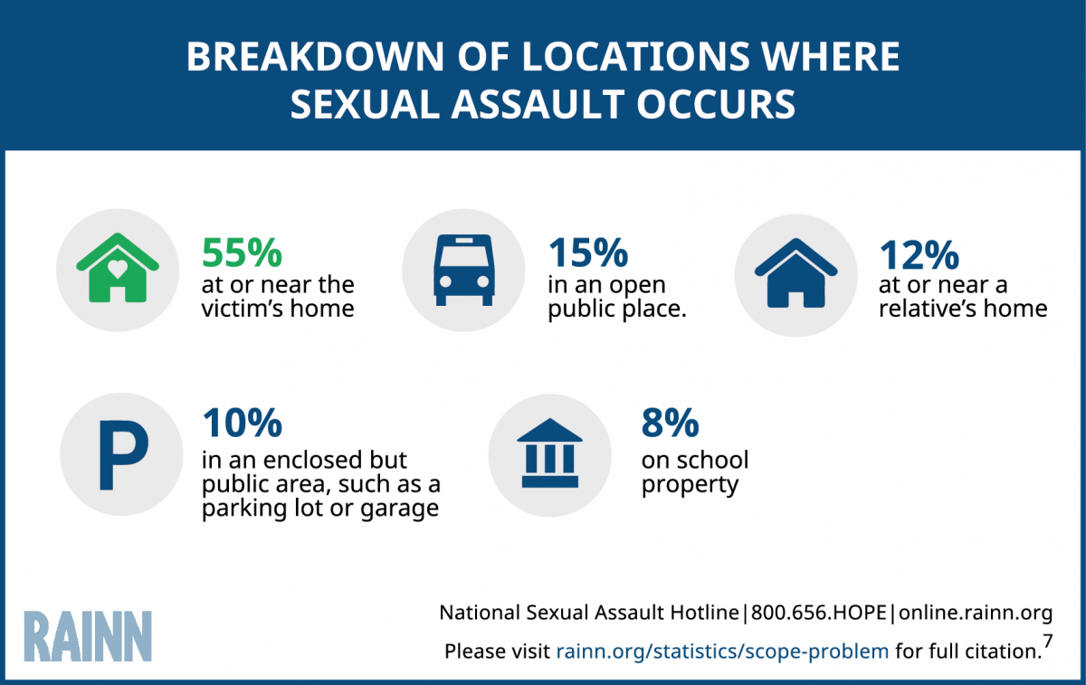
MORE MYTH BUSTERS
MYTH
FACT
Sexual Assaults occur in dangerous places
Notes:
SOMB Approved Treatment Provider or PO present this slide
(It is important to stress the “INADEQUACY” of residence restrictions. THEY DON’T WORK!) Sex crimes usually happen in the offender’s home or the victim’s home, which has nothing to do with living near a park, church, daycare center, etc. (Begin planting the seed here on this slide, and later more will be said about residence restrictions.)
Research: http://dcj.state.co.us/odvsom/Sex_Offender/index.html , resources, reports, White Paper on the Use of Residence Restrictions as a Sex Offender Management Strategy (SOMB)
Even though stranger danger is real, stress the most dangerous person might be the one you are currently allowing babysit your child! When is the last time anyone in the audience has checked the sex offender registration list?
Research re: victim knows offender: Douglas, Emily, and Finkelhor, D., Childhood sexual abuse fact sheet http://www.unh.edu/ccrc/factsheet/pdf/childhoodSexualAbuseFactSheet.pdf

Slide 20
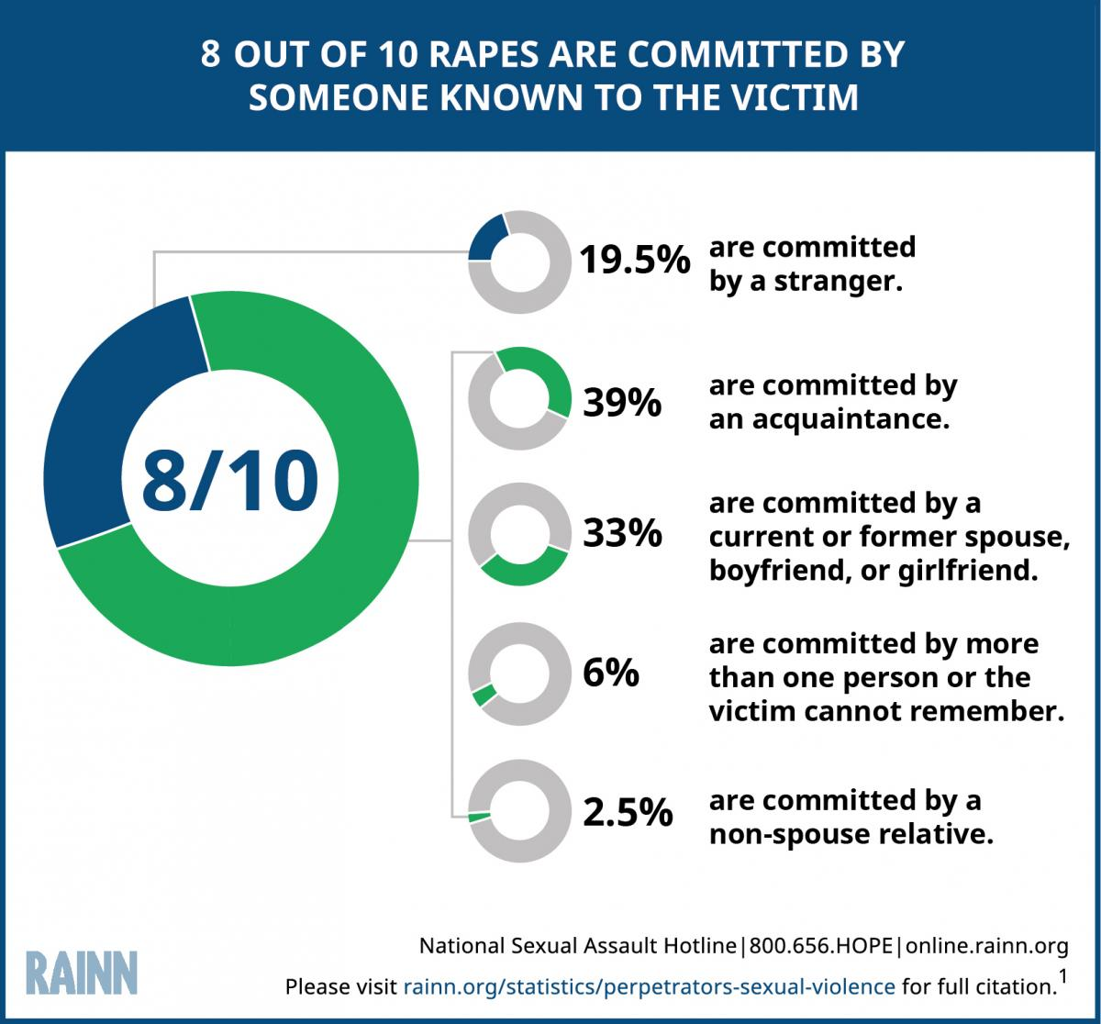
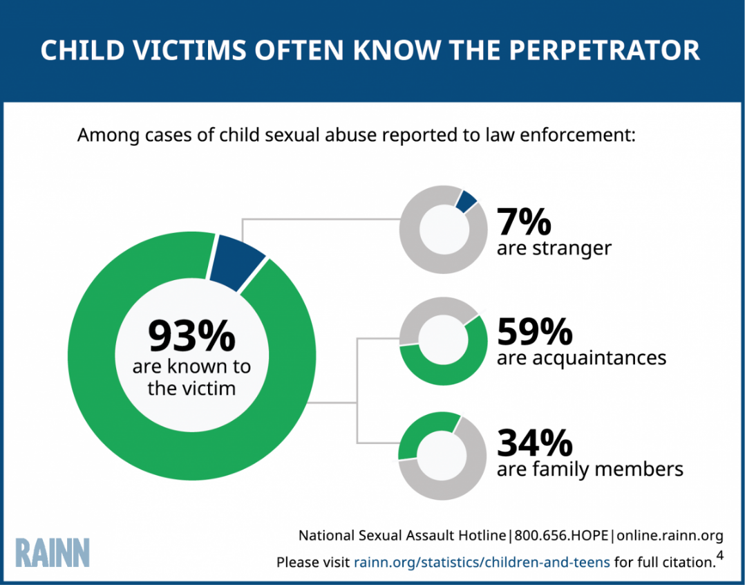
STATISTICAL REALITY
Notes:
LE to present this slide
A 1997 study shows that in 90 percent of sex offenses committed against children less than 12 years old, the child knew the offender. Three years later, in 2000, that number had increased to 93% known to the child.
Only 7% of the perpetrators of child victims were strangers
34.2% were family members and
58.7% were acquaintances
Make the point with the public that their children have a greater chance of being sexually assaulted by a relative or acquaintance than they do by a stranger. We do our children a great disservice when we only talk to them about stranger danger because when the abuser is someone they know, love or trust, the child suddenly wonders what they did wrong to be victimized. We should be teaching children to communicate with mom and/or dad if anyone touches them where their bathing suit covers, or in a way that makes them feel uncomfortable, regardless of who it is.

Slide 21
ALCOHOL & DRUGS
DID YOU KNOW?
It is a felony crime to have sex with someone who is under the influence of drugs or alcohol and who is “physically helpless” or incapable of appraising the nature of their actions.
C.R.S. 18-3-402 (b), (h)
Notes:
LE TO Present next 3 slides
This is really important for parents to teach their teenagers, who may be attending parties and/or getting intoxicated.

Slide 22
SEXUAL ASSAULT
C.R.S. 18-3-402, 18-3-405, and 18-3-405.3
It is illegal to have sexual relations if:
The victim is less than 15 years of age, and actor is at least 4 years older than the victim (but less than 17 years of age);
The victim is less than 18 years of age and the actor is in a “position of trust” with respect to the victim;
The victim is at least 15 years of age, but less than 17 years of age, and the actor is at least10 years older than victim, and not spouse of victim, or victim in custody of law or detained in a hospital; victim is helpless physically, etc.
Notes:
V = under 15; Offender at least 4 years more (but less than 17)
V = at least 15, but less than 17, and offender 10 years older than victim and not spouse or of custody, etc.
Again, parents and teens should know this information.

Slide 23
INTERNET EXPLOITATION OF A CHILD
“… who is at least 4 years older than a child who is under 15 years of age, knowingly entices the child through communication via computer network or system to: expose; touch the child’s own or another person’s intimate parts while communicating with the person via a computer; observe the person’s intimate parts while communicating with the person.
This includes SEXTING!
Notes:
CRS 18-3-405.4 Sexting is a problem
** Approximately 1 in 7 (13%) youth Internet users received unwanted sexual solicitations.
4% of youth Internet users received aggressive solicitations, in which solicitors made or attempted to make offline contact with youth.
9% of youth Internet users had been exposed to distressing sexual material while online.
Wolak, J., Mitchell, L., Finkelhor, D. Online Victimization of Youth: Five Years Later, National Center for Missing & Exploited Childlren, 2006, Available online: http://www.missingkids.com/en_US/publications/NC167.pdf
Are sexting citations.
18-6-403 (3) (a), a class 3 felony if committed by an adult, or Sexual Exploitation of a Child under section 18-6-403 (3) (b.5) a class 6 felony if committed by an adult.

Slide 24
POSTING, POSSESSION, OR EXCHANGE OF A PRIVATE IMAGE BY A JUVENILE:
“SEXTING”
It is illegal for anyone 18 years or older to Post, Possess or Exchange images of anyone who is at least less than 14 or less than 4 years younger.
POSTING: Class 1 or 2 Misdemeanor
  Knowingly distributes, displays or publishes image another who is at least 14 or is less than 4 years younger without permission;
  OR of him/herself if the recipient didn’t request it and suffered emotional distress
  OR the poster knew or should have known that the depicted person had a reasonable expectation of privacy.
POSSESSION: Petty Offense or Class 2 Misdemeanor
  Knowingly possesses image of another who is at least 14 or is less than 4 years younger without permission.
EXCHANGING: Civil Infraction
  Knowingly sends an image of self to another who is at least 14 or is less than 4 years younger and reasonably believed the recipient agreed;
  OR Knowingly possesses an image of another who is at least 14 or is less than 4 years younger and reasonably believed depicted person agreed.
  C.R.S. 18-7-109

Slide 25
COMMUNITY SUPERVISION
Sexual offending behavior is often repetitive and there is a continuing risk that adult sex offenders will re-offend.
Most sex offenders in Colorado are supervised by the criminal justice system in the community.
PO’s monitor conditions and behavior, & impose sanctions.
Sex offenders must waive confidentiality for treatment & case management purposes.
Secrecy undermines rehabilitation & threatens public safety.
Sex offenders must be completely accountable for their behavior & must agree to intensive & intrusive measures.
Notes:
Probation/Parole present next 2 slides
(In this slide you are just going over what Colorado’s form of supervision looks like. You will review the specific conditions of the SVP, once we have introduced the subject of the meeting.)
65% of sex offenders in Colorado are sentenced to community supervision but the majority of registered sex offenders in Colorado are not under supervision (approximately 5,000 supervised of over 16,000 registered)
Emphasize that supervision is intensive and collaborative and difficult but not impossible. The focus is community and victim safety before offender needs. Risk and needs are constantly assessed and responded to in order to feasibly mange the offender.

Slide 26
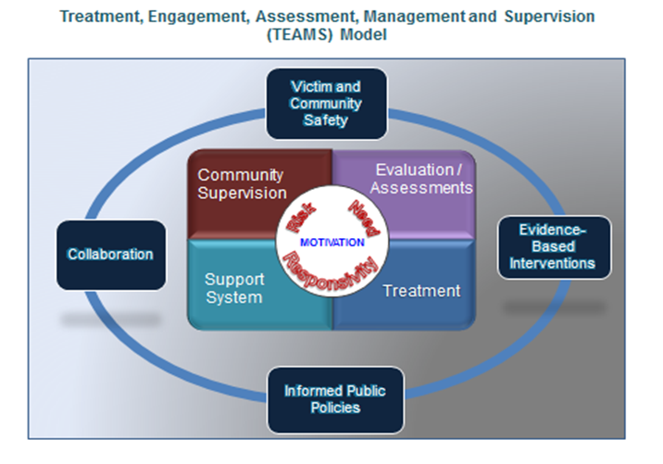
COMMUNITY SUPERVISION APPROACH
Notes:
This is a diagram of what the containment approach looks like. Community members can be the eyes and ears for LE or the supervising officer. Explain that supervision requires collaboration from all members in order to effectively contain an offender.

Slide 27
MYTH BUSTERS: Victims
MYTH
Most Victims “ask” for it
Victims who suffer NO OBVIOUS physical injury are not seriously traumatized by their experience
FACT
Sex offenders use power and control to dominate and humiliate victims of both genders.
Only about 4% of rape victims sustained serious physical injuries as a result of rape. 70% reported no physical injuries. ALL victims suffer.
Notes:
A Victim Advocate or LE or DA can present the next 3 slides:
(Keep in mind you are wanting to dispel myths about victims as well.) Unfortunately, in society victim blaming is common. An example of victim blaming is looking at how some teenage girls dress these days, (which is our culture). They are not “asking for it”, they are dressing like most other teenagers. Offenders still have a choice to commit a sex crime. Most victims do not sustain physical injuries that you can see with your eye. Most injuries are internal, and life long sustaining damage to the soul.

Slide 28
IMPACT ON VICTIMS OF
SEX OFFENSES
Victims exhibit many different responses: crying, angry, quiet, withdrawn. There is no “normal” response.
Sex assault by someone known to victim creates more difficult recovery.
Victims often develop post-traumatic stress disorder.
Long-term effects inc.: depression, anxiety, eating disorders, flashbacks, divorce, loss of sexual interest, loss of concentration, sleeping disorders, suicide.
Male victims tend to develop anti-social behaviors; females tend to develop depression; both develop substance abuse problems.
Notes:
Colorado is a state that considers victim and community needs and safety first.
(The second bullet is especially important, since most victims are assaulted by someone they know. These are not all inclusive lists but highlights.)

Slide 29
IMPACT ON VICTIMS OF
SEX OFFENSES
Victims of sexual assault are 3 times more likely than the general population to suffer from depression;
Are 13 times more likely to attempt suicide;
Have greatly increased rates of substance use and abuse;
Are likely to engage in poor contraceptive use;
And have a higher rate of unwanted pregnancy. (CCASA, 2003)
Victims of sexual assault have an increased risk of involvement with the judicial system (Widom, 1995)
Responses are minimized when victims are believed & supported.
Notes:
It is really important to stress that all victims need support regardless of the situation.

Slide 30
COMMUNITY RESPONSIBILITY
The community has a vested interest in helping offenders be successfully managed in the community.
Harassment is counter-productive to the goals of
community management & may cause offenders to go underground
Sex offenders have the same need for housing &
employment as other citizens
Notes:
LE to present next 2 slides.
(Sometimes a safety officer has presented this slide. The purpose of this slide is to remind the community of their role, and it is safer for them to offer “support” to LE in maintaining the stability of the SVP and other sex offenders living in their community.) Proximity Laws don’t work very well, and eventually offenders have proven they will stop registering, which elevates the risk to the community.
A victim is a victim in this town, or another town. Do we really want to push an offender out of our town just so they can victimize someone else? Why not deal with the problem, and assist the supervision team in reducing the offenders’ risk to re-offend.

Slide 31
COMMUNITY SAFETY REMINDERS
A stable offender equals increased community safety
(Bumby & Talbot CSOM 2000)
Any citizen who uses this information to harass, threaten, or intimidate will be subject to criminal prosecution.
Notes:
(A good place to give some education regarding residence restrictions.)
Approximately 22 States and hundreds of municipalities have passed ordinances prohibiting sex offenders from residing within a certain distance from schools, parks, or other areas children congregate. Colorado as a state does not have a residency restriction but 5 local jurisdictions have municipal ordinances. One of which was successfully sued by the ACLU due to constitutional issues costing that jurisdiction over 1.5 million dollars. There is no evidence that residence restrictions prevent repeat sex crimes. There is evidence, however, that residence restrictions make sex offenders disappear and remove protective factors that impact recidivism. In fact, those who were initially advocating for the law, are now actively trying to rescind it.
Minnesota Dept. of Corrections studied residence restrictions by evaluating 224 sexual offenders who were arrested for a repeat sex crime when they were released from prison between l990 and 2002, and who were re-incarcerated by 2006 for a new sex crime. NONE of the sex offenses would have likely been deterred by residence restriction. They found that over 65% of the sex crimes the victim KNEW the offender, and the other 35% of crimes occurred by being apprehended on the street, in a bar, or by breaking into the home. None of the cases involved an offender who developed victim contact near a school, park, or day care center. In fact, 57% of those cases used a ruse to gain contact with their victim. (Crime and Justice, DCJ, ORS, 2007)
Within 6 months of the implementation of the State of Iowa’s 2,000 foot residence restriction law, thousands of sex offenders became homeless or transient. The number of sex offenders who did not register, and could not be located more than doubled. (Iowa County Attorneys Association, 2006)
The assumption that children are at great risk posed by sexual offenders lurking in schoolyards, playgrounds, etc, is misleading, and can create a false sense of security. Remember, most sexual abuse occurs by someone the victim knows, and we are at greatest risk at home, or with those we already know.

Slide 32
SUBJECT OF NOTIFICATION
  SVP Bulletin
Notes:
LE to present all slides related to the subject of CN
Place the actual SVP bulletin here, with all pertinent information (use form in Criteria, Protocol, & Procedures) Be sure to be careful about identifying the SVP’s place of employment, unless you’ve spoken with the owner of the company ahead of time, and he/she has a “heads up” about it. Stable employment is a key factor in reducing recidivism. If you are using note cards for question and answer at the end of this presentation, please have someone help collect them now so you can start filtering through them.

Slide 33
AN SVP BECAUSE: Age…
First Criteria:
Must have been age 18 at the
time of the offense, or had
been tried as an adult.
This SVP:
This SVP’s age at the time
the offense was committed.
Notes:
LE present next 4 slides:
Fill in the specifics on the right side. This is to show how this particular SVP was labeled/designated. If his status is out of state, delete these slides and report Colorado law mandates we honor the designation or it’s equivalent status give by other states.

Slide 34
AN SVP BECAUSE: Timeframe
Criteria for SVP
The crime must have been committed
on or after July 1,l997 and convicted on
or after July 1, l999.
This SVP
This SVP’s date of crime and
date of conviction:
Notes:
You are just showing the SVP’s crime date and conviction date.

Slide 35
AN SVP BECAUSE: Crime of Conviction…
Criteria for SVP
A. Sexual Assault
B. Unlawful Sexual Contact
C. Sexual Assault on a child
D. Sexual Assault on a child/position of trust
(Includes Attempts, Conspiracies or solicitations.)
This SVP
This SVP’s conviction:
Notes:
You are just showing the SVP’s conviction. IF there is sensitive information contained in the conviction that could potentially identify the victim, use your discretion in displaying this info. It is public record so you can use it but always do your best to protect the identity of the victim.

Slide 36
AN SVP BECAUSE: Relationship…
Criteria for SVP
The victim’s relationship with the
offender must have been either:
A. A stranger
or
B. A person with whom the offender established or promoted a relationship primarily for the purpose of sexual victimization
This SVP’s
The victim was (A or B) to the
offender…
Notes:
You are saying the offender met the “relationship criteria” and you can indicate that it was either A or B. You do not need to provide any details. You do NOT want to potentially identify the victim by giving age, gender, etc.

Slide 37
AN SVP BECAUSE: Criminal History…
Criteria for SVP
Positive results, or scoring high enough
on the risk assessment instrument,
which includes assessment of the
following:
* presence of mental abnormality
* prior sexual conviction(s)
* risk factors related to sexual re-offense
(Administered by probation/parole and treatment evaluator)
This SVP
This SVP was evaluated and recommended to be SVP. The court/parole board designated him as a Sexually Violent Predator.
(Or this SVP was identified as ** in
another state, and CBI determined the offender met the criteria for Colorado)
Notes:
Just say the offender scored in a manner on the assessment that required a recommendation for SVP designation, and therefore the court or Parole Board made a finding that this person is a SVP. If he/she was designated out of state, be sure to eliminate these slides, and just say whichever state gave original designation and that our state honored it.

Slide 38
** SVP NAME & LEGAL STATUS
IF the offender IS NOT on probation or parole in Colorado: (leave blank and provide explanation during presentation.)
IF the offender IS under community supervision: (list specific probation/parole terms & conditions)
  Mandates
  Prohibitions/Restrictions
Notes:
PO present this slide
If the SVP IS supervised, the supervising officer should present this information, along with specific terms and conditions of his/her parole/probation. Change title of slide to include SVP name and if on probation or parole (i.e. John Smith – Parole)
** This is where you would add some slides to identify specific probation/parole conditions. Make sure you provide the conditions that would be most relevant to a general audience: such as: this offender cannot frequent bars; the offender’s curfew; the offenders’ no-contact conditions; or specific Court ordered conditions, etc. You can be general (i.e. curfew, contact with minors and victims, etc.)

Slide 39
REGISTRATION REQUIREMENT
SVP’s must register with law enforcement
  Quarterly
  Lifetime
  Internet Identifiers and email address
  Residence must be verified quarterly by the Police Department
Notes:
LE present this slide
This is a point where LE can inform audience about what LE does and can do regarding SVP. This is especially important if the offender is NOT on any form of supervision. The more LE can share about what they do to maintain some form of awareness of the SVP, the more it might quell some fears of the offender. Especially let the audience know that LE makes PERSONAL residence verification and what the consequences are to the SVP if they fail to comply.

Slide 40
SCHOOLS, PARKS, BUS ROUTES NEAR SVP’S RESIDENCE
  List schools, park (s), recreation centers and bus routes if desired/applicable
Notes:
If applicable, identify the “vulnerable groups” that reside near the SVP. This is at the discretion of law enforcement and can be done on a case by case basis dependent upon the history/patterns of the SVP. (schools, daycares, rec centers, senior centers, bus stops, etc.)

Slide 41
COMMUNITY PROTECTION & SAFETY ISSUES
SVP’s Do Not Represent All Dangerous Sex Offenders,
& the Community Notification process is not a complete deterrent to sexual assault.
Notes:
LE present this slide
(Again, it’s important to stress that the most dangerous offender out there is the one who is NOT identified not registered, NOT in treatment or under any form of supervision. With the audience ‘armed’ with new information about offender and victim characteristics, perhaps they can begin to think more critically about persons whom they know that MIGHT be an offender!) “The SVP is NOT the only dangerous person out there. There are unidentified offenders not yet caught and offenders who are registering that they should also be cautious of.”

Slide 42
PLEASE REMEMBER….
Vigilantism, harassment, threats or intimidation of the offender is counter-productive to the best interests and safety of the community.
We want them to be:
  Registered and visible in the community
  Not go “underground” or provide false information
  Such activity is criminal and will be investigated and the actor will be subject to prosecution
Notes:
LE to present this slide
“We just want to remind the audience the need for their support, that vigilantism is counterproductive because unstable offenders are more likely to reoffend, and that sex offenders have legal rights regardless of how citizens feel about them.”

Slide 43
Communication is Key
What can I tell my children about the SVP?
Avoid scary details.
Use language that is honest and age-appropriate.
Teach your children not to visit offender’s home or yard, but also not to harass them.
Teach your children to TELL a SAFE ADULT if anyone acts inappropriately towards them (i.e. creepy, too friendly, threatening, not respecting their boundaries, etc.)
Notes:
A victim advocate or therapist, or a safety officer/LE can present this slide.
(If there is other information you want to share, be sure to put it in the slides! Summarize tips for citizens and offer to be available for citizens when they have questions or concerns.)

Slide 44
Child Abuse Prevention
What can I teach my children:
Pay attention to your child’s thoughts/feelings
Role play with your child: Act out scenarios of various dangerous situations and teach them how to respond
Avoid high risk situations
Be observant of your surroundings
Be thoughtful and use good judgment when choosing friends/partners
Teach appropriate social behaviors
Teach correct names for body parts
Teach children that adults are NOT ALWAYS right
Teach the importance of honesty and the danger of keeping secrets
Notes:
LE , victim advocate or safety officer present this slide:
(Be sure to share other pertinent information as you see fit. Remind audience how important communication is with children because sex offenses occur in secrecy and through manipulation and deception.)

Slide 45
RESOURCES
  Colorado Bureau of Investigation (CBI) website:
    http://sor.state.co.us/
  Colorado Sex Offender Management Board website:
    http://dcj.somb.state.co.us/
  Dru Sjodin National Sex Offender Public Website:
    http://www.nsopw.gov/Core/Conditions.aspx
  National Sexual Assault Hotline at: 800-656-HOPE
  RAAIN Rape, Abuse & Incest National Network
    https://rainn.org/
  National Center for Missing and Exploited Children website:
    http://www.missingkids.com
  The Center for Sex Offender Management website:
    http://www.csom.org
Notes:
LE or Vic Advocate present this slide
“What can citizens DO?
One tip is to check the sex offender registry before their kids attend an overnight, birthday party, etc. of a friend whom they do not know.
Here are some resources: Dru Sjodin’s website takes you to the agreement of conditions of use page and has great safety and education information, as well as the registry. The SOMB website has a lot of information about sex offenders under the resources, community education tab.”
“The National Sexual Assault Hotline is confidential and information can be provided anonymously.”
(Other references for education, as well as the bottom web address is Colorado for sex offender registry)

Slide 46
**IN PERSON TOWN HALL***
QUESTIONS & ANSWERS
GROUND RULES
  1. Questions only. No editorials or comments will be allowed.
  2. Questions will be taken by ADULTS ONLY.
  3. One question per person. Second questions may be permitted after all the first questions have been addressed and if time allows.
  4. All participants are expected to conduct themselves in an orderly and respectful fashion.
  5. Personal sexual assault experiences should not be discussed during this time. A victim services representative will be available after the meeting for audience members to meet with privately.
  6. Anyone attempting to disrupt the meeting will be asked to leave and be escorted out by law enforcement.
Notes:
LE to present this slide
(Remind audience of the Q & A format, then proceed to Q & A!)
If they are using index cards, adjust the Q & A Ground Rules accordingly. If you are utilizing index cards, some departments have offered to answer remaining questions on their website if they do not get to all of them. Pass out the note cards to the appropriate panel members to answer. Do not read statements, repeat questions, or anything your department would interpret as inappropriate. If you already answered a question in the presentation you do not need to say it again.

Slide 47
**ALTERNATIVE NOTIFICATION**
Contact Us:
Should you have any questions about this community notification, you can contact the ***Police Department/Name of Officer
  Email
  Phone

Slide 48

COMMUNITY NOTIFICATION
INFORMED
COMMUNITIES
ARE SAFER
COMMUNITES
(SOMB 5/15)
Notes:
Yea, you are done and were a success! ☺

